Slide 1


Green Pace
Security Policy Presentation
Developer: Tyler Glover

Slide 2

OVERVIEW: DEFENSE IN DEPTH
National Institute of Standards and Technology: "Failure protection strategies that employ replication of policy enforcement mechanisms, sometimes called defense in depth, can allow the system to continue in a secure state even when one mechanism has failed to protect the system."

Slide 3
THREATS MATRIX
Likely STD-002-CPP STD-003-CPP STD-005-CPP STD-006-CPP STD-008-CPP STD-009-CPP | Priority STD-001-CPP STD-004-CPP STD-010-CPP
Low priority STD-006-CPP | Unlikely
Each coding standard is described by a threat rating dictated by this threat matrix.

Slide 4
10 PRINCIPLES
Validate Input Data – STD-001-CPP, STD-002-CPP, STD-004-CPP, STD-006-CPP, STD-007-CPP
Heed Compiler Warnings - STD-009-CPP
Architect and Design for Security Policies - STD-004-CPP, STD-007-CPP
Keep It Simple - STD-003-CPP, STD-005-CPP
Default Deny - STD-004-CPP
Adhere to the Principle of Least Privilege - STD-004-CPP
Sanitize Data Sent to Other Systems
Practice Defense in Depth - STD-006-CPP
Use Effective Quality Assurance Techniques – STD-001-CPP, STD-002-CPP, STD-003-CPP, STD-005-CPP, STD-006-CPP, STD-008-CPP
Adopt a Secure Coding Standard – STD-001-CPP, STD-002-CPP, STD-003-CPP, STD-005-CPP, STD-008-CPP, STD-010-CPP

Slide 5
CODING STANDARDS
STD-001-CPP: Choose Appropriate Data Types
STD-004-CPP: Use Prepared Statements When Querying
STD-010-CPP: Avoid Using Input With Format Strings
STD-002-CPP: Avoid Calculations that Result in Overflows
STD-005-CPP: Only Access Properly Allocated Memory
STD-003-CPP: Avoid String Overflow and Truncation
STD-007-CPP: Respect Function's Possible Exceptions
STD-008- CPP: Handle Memory to Prevent Leaks
STD-009-CPP: Do Not Modify String Literals
STD-006-CPP: Use Assertions to Guarantee Expected Program State

Slide 6
ENCRYPTION POLICIES
Encryption at Rest: Stored data policies
Will be encrypted as necessary using the AES-256 encryption algorithm
Encryption in flight: Data communication
Data will only be sent via HTTPS communication. Unsecure HTTP connections will not be used to send data over the network.
Encryption in use: Data in active memory
Homomorphic encryption will be used to process data without decryption when possible. Sensitive data will not be held in active memory once it is no longer needed. Sensitive data will be overwritten, not just freed.

Slide 7
TRIPLE-A POLICIES
Authentication – Prior to accessing system resources industry standard authentication methods will be used to confirm the user's identify.
Authorization – Permission profiles will be developed for each user role in the system. The Principle of Least Privilege will be applied for all user accounts. Administrative accounts will only be used when necessary.
Accounting – All user activity will be logged. The user, resource accessed, time of access, and activity performed will be logged.

Slide 8
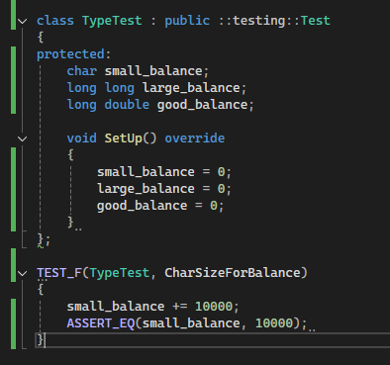
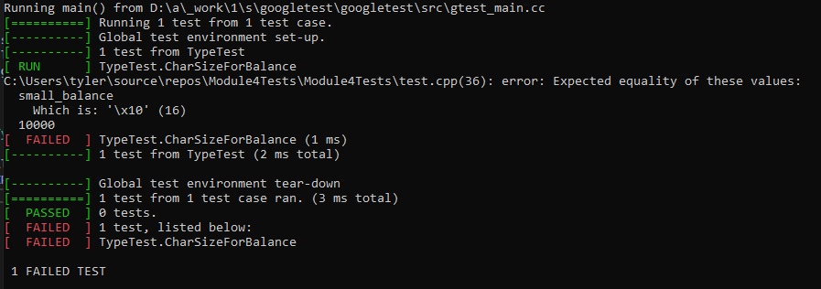
Unit Testing – Data Types

Slide 9
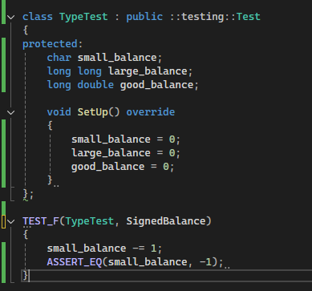
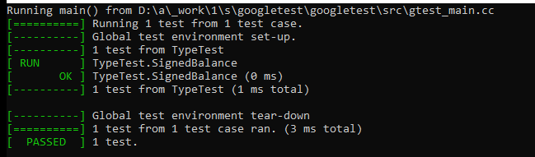
Unit Testing – Data Types

Slide 10
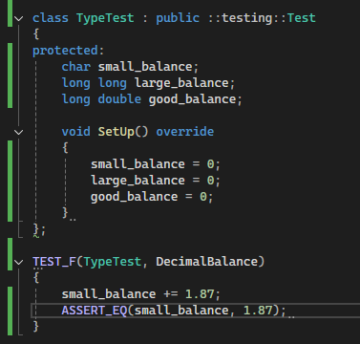
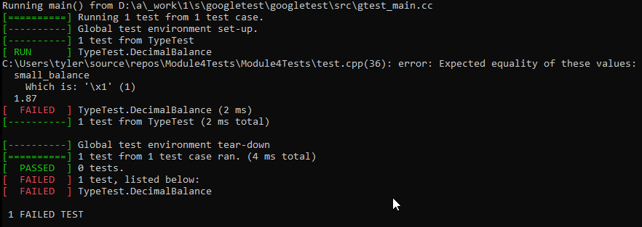
Unit Testing – Data Types

Slide 11
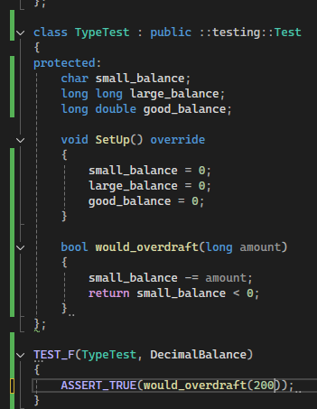
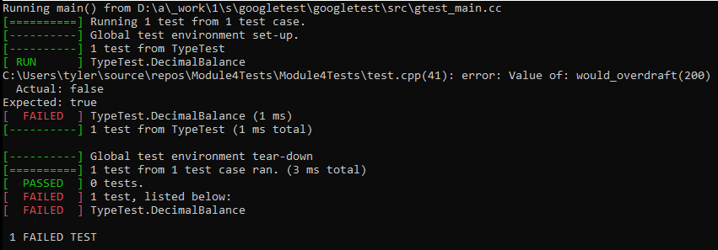
Unit Testing – Data Types

Slide 12

AUTOMATION SUMMARY

Slide 13
TOOLS
Development SECURITY Operations
Tools
Code Analysis
CodeSonar
Polyspace Bug Finder
Parasoft
Coverity
Astree
C++ Compiler
Google Unit Test Framework
System logs

Slide 14
RISKS AND BENEFITS
Priorities – Resolve High Risk Vulnerabilities and Apply Developer Tools
Target high priority code standards first
STD-001-CPP: Choose Appropriate Data Types
STD-004-CPP: Use Prepared Statements When Querying
STD-010-CPP: Avoid Using Input With Format Strings
STD-002-CPP: Avoid Calculations that Result in Overflows
STD-005-CPP: Only Access Properly Allocated Memory
Apply strong user passwords, system keys, and antivirus software for employee devices.
Implement code analysis developer tools.

Slide 15
RECOMMENDATIONS
Additional defense in depth requirements not yet addressed in the policy:
Physical access restriction examples should be added. These may include key card access and surveillance cameras.
Physical security exploitation example: https://www.techradar.com/pro/security/talk-about-an-unexpected-charge-criminals-deploy-raspberry-pi-with-4g-modem-in-an-attempt-to-hack-atms
Endpoint security should also be addressed. This means that user devises should be secured. This may include antivirus software and proper computer password and system key securities.
A more fleshed out security training policy should be established. This should include a training schedule for all employees.
Incident response plan

Slide 16
CONCLUSIONS
Defense in Depth
Threat analysis
Security Principles
Coding Standards
Encryption Policies
Unit Testing
Automation
Tools
Risks and Benefits
Recommendations

Slide 17
REFERENCES
Akindehin, I. (2023, November 5). Incident case study: Unauthorized access and data breach. Medium. https://medium.com/@ibitolabif/incident-case-study-unauthorized-access-and-data-breach-fe518a506951
National Institute of Standards and Technology. (2020). Security and privacy controls for information systems and organizations (NIST Special Publication 800‑53 Rev. 5). U.S. Department of Commerce. https://doi.org/10.6028/NIST.SP.800-53r5
SEI CERT. (n.d.). SEI CERT C++ Coding Standard. Retrieved August 15, 2025, from SEI CERT website: https://wiki.sei.cmu.edu/confluence/pages/viewpage.action?pageId=88046682
Udinmwen, E. (2025, August 9). Talk about an unexpected charge — criminals deploy Raspberry Pi with 4G modem in an attempt to hack ATMs. TechRadar Pro. https://www.techradar.com/pro/security/talk-about-an-unexpected-charge-criminals-deploy-raspberry-pi-with-4g-modem-in-an-attempt-to-hack-atms

